Slide 1
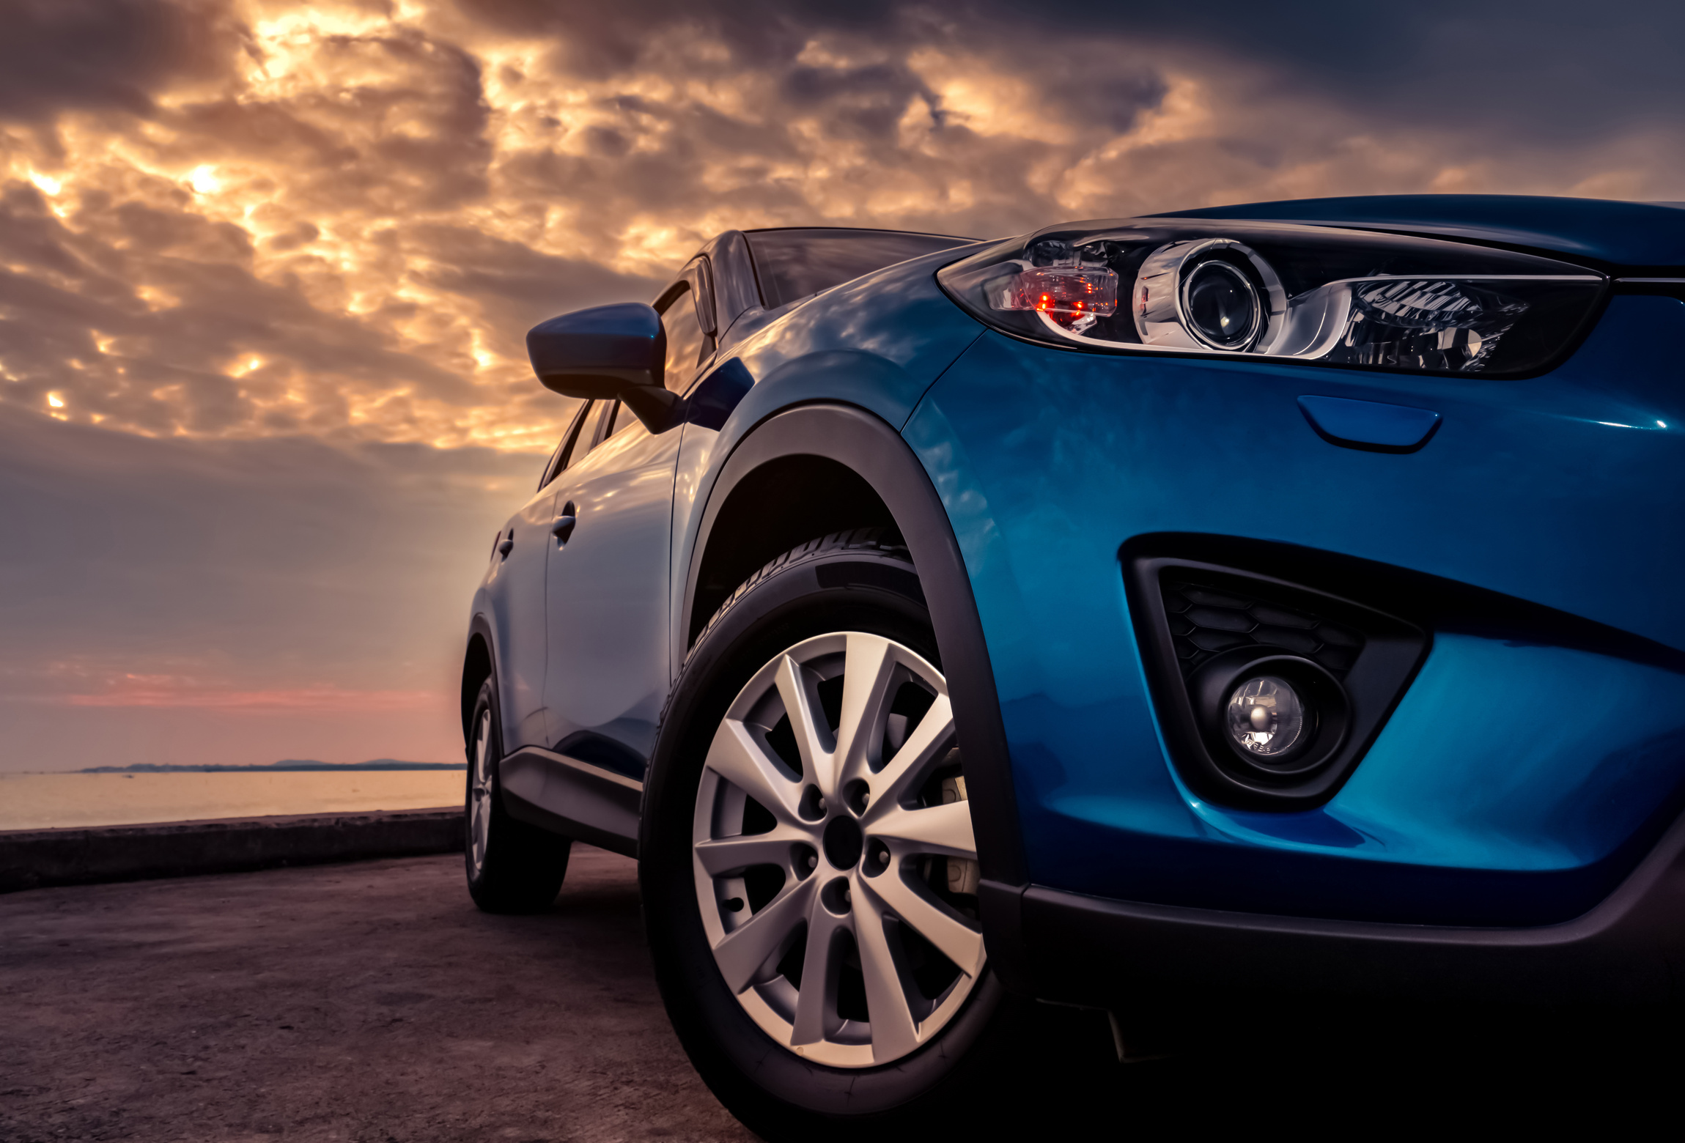




Drive Safety
Route Eye
Route Eye System
Project
Detection And Alert System For Drowsiness Drivers Using CNN Model Technology And IOT
2024

Slide 2


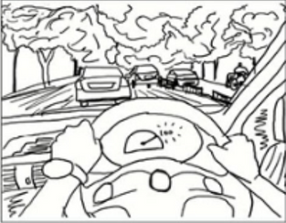
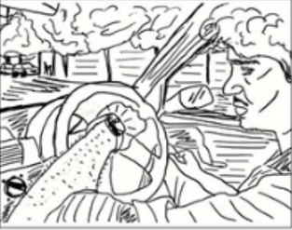
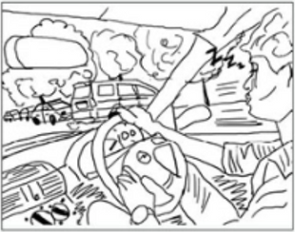
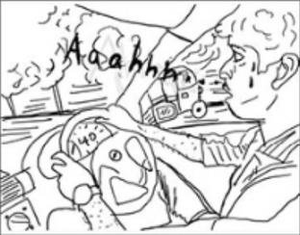
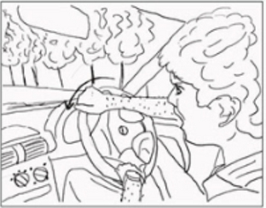
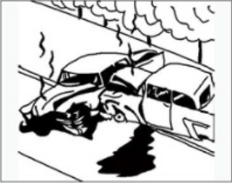
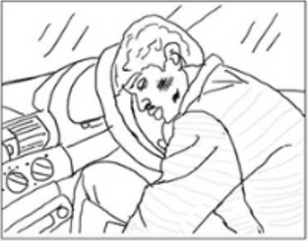
Bad Story
Drowsiness

Slide 3

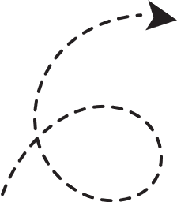


Problem
1.35 Million
Road Traffic Deaths every year
1st
Road traffic injuries are
Leading cause of death
cause of death among children aged 5-14 and among young adults aged 15-29
8th
Every 24 Seconds Someone Dies On The Road

Slide 4
Problem Statement
Driver Drowsiness leads to accidents.
Existing solutions are often expensive or lack effectiveness.
Need for proactive accessible solutions for safer driving experiences.

Slide 5
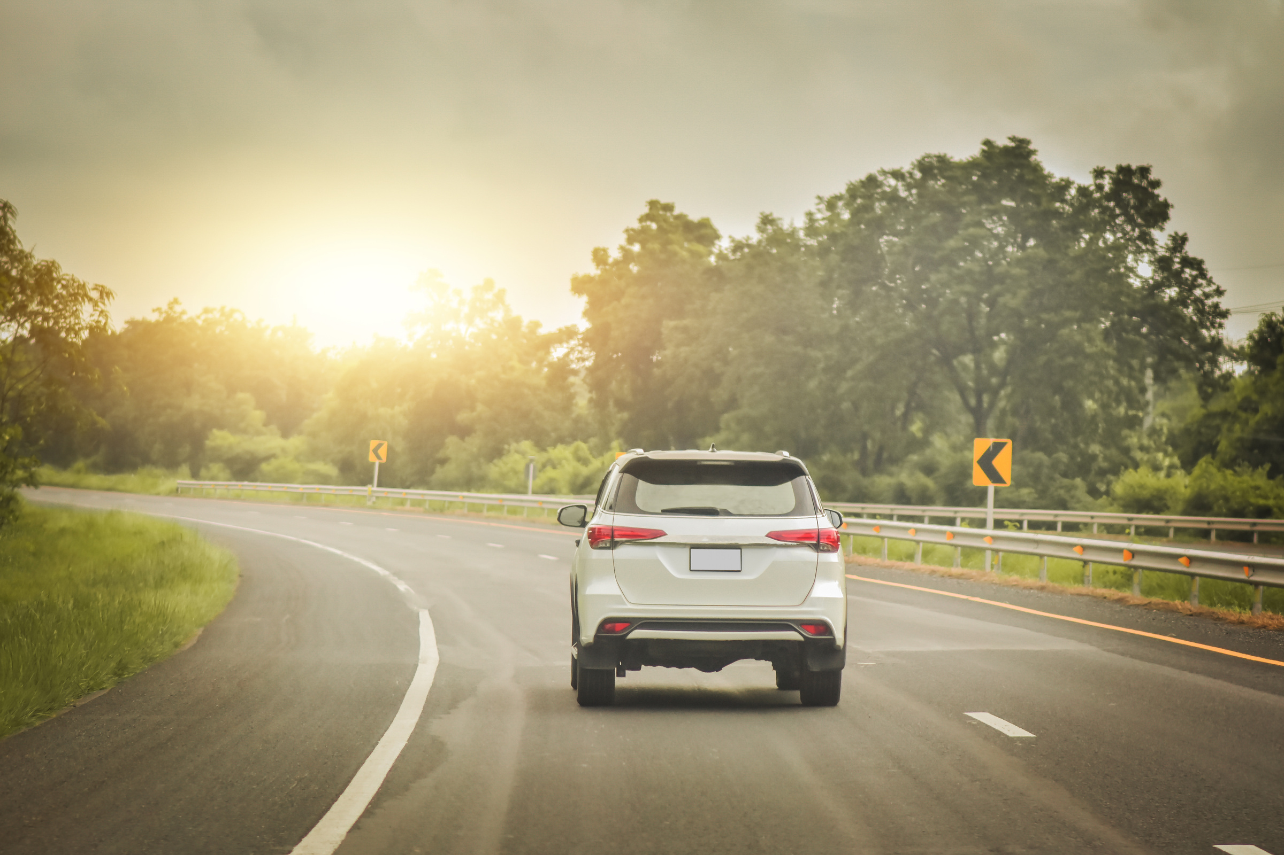
Our Mission
Driver Safety
Detect and prevent Drowsiness using advanced Deep Learning models and IOT technique for Alerts.

Slide 6


Our Solution

Slide 7
Solution Overview
The Route Eye System utilizes advanced deep learning algorithms and real-time image analysis to enhance driver safety by detecting driver drowsiness.
It operates through a user-friendly mobile app and leverages the device's camera to monitor the driver and surroundings.

Slide 8
Solution Overview
The app provides timely alerts to drivers, promoting awareness and preventing potential accidents.
The Route Eye System incorporates Internet of Things (IoT) technology and specialized hardware to enhance its alert system for driving safety.

Slide 9
Key Features
feature: Drowsiness Detection .
Graded alert system: LED light, sound Alert, seat vibration, App Notification.
Real-time monitoring for a safer driving experience.

Slide 10

How Route Eye System Works

Slide 11





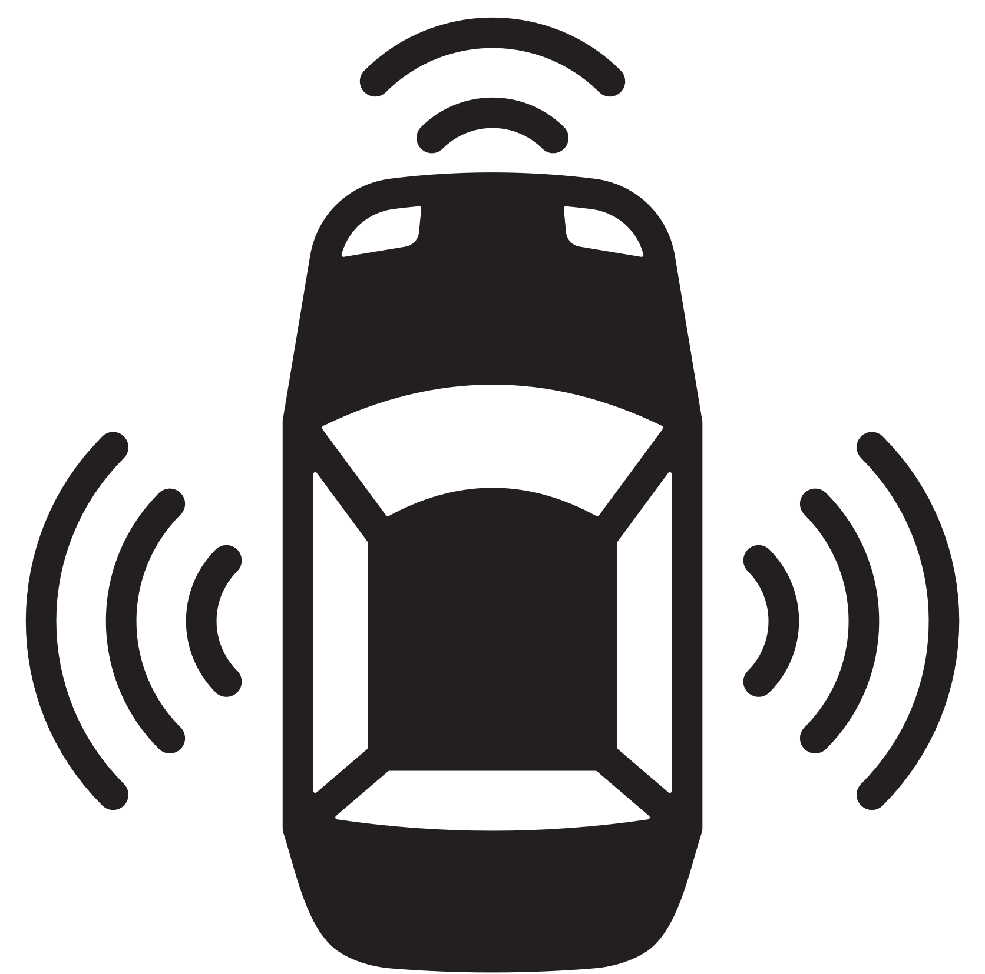
How It Works?
01
02
03
04
05
Driver mounts the mobile device on the car dashboard.
Mobile camera captures images every second.
Drowsiness Detection using deep learning models.
Multi-tiered alert system for timely notifications using IOT.
Take a one or more of user-defined Precautionary actions.

Slide 12
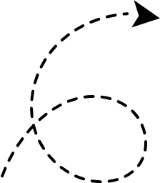

Technology Used
Tools Used
AI
Tensorflow
IOT
Flask
Mobile APP
Flutter

Slide 13
How It Works?
Mobile Application
The front camera of the mobile device captures images at regular intervals.
Images are taken by a timer that triggers every 1000 milliseconds (1 seconds).
The frame image is converted into a text-based represented image, then transmitted over HTTP protocol to the API.
App displays current status that ensures timely detection to prevent accidents.

Slide 14
How It Works?
Flask Application
The Flask application is the backend server of the system, which hosts the CNN model and communicates with the Flutter app.
dlib library is a C++ library presents a method that precisely estimates the positions of facial landmarks using a training set of labeled facial landmarks on images.
The API employs facial recognition algorithms by using dlib library to accurately locate and crop the regions of interest, specifically the eyes and mouth.

Slide 15
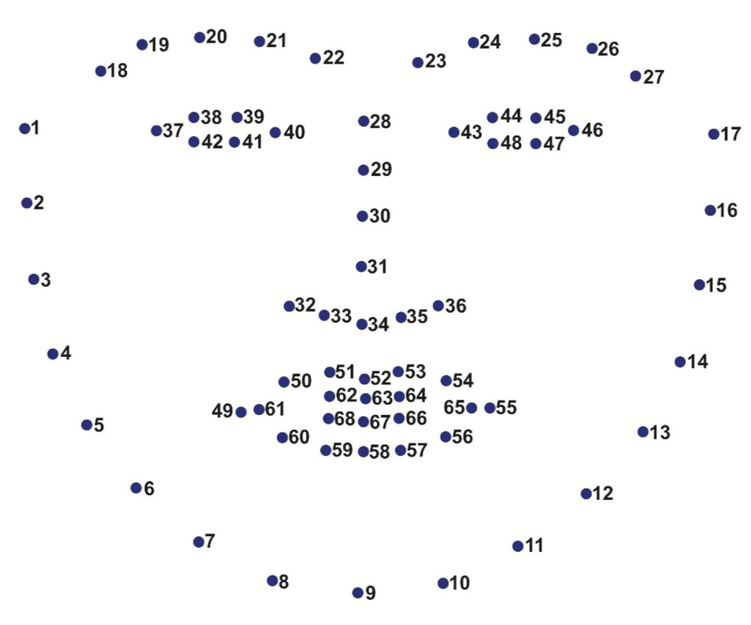
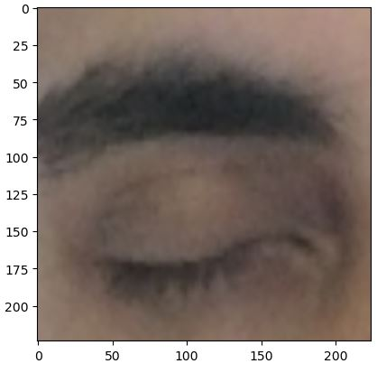
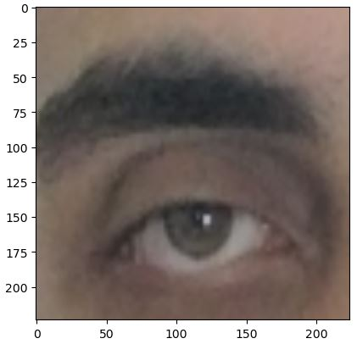
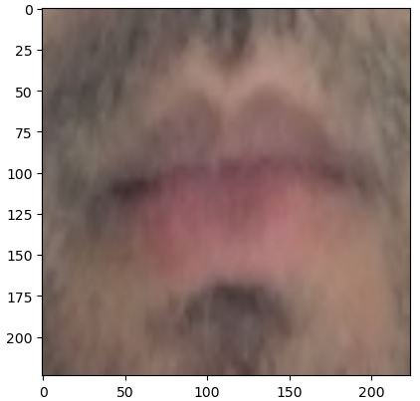
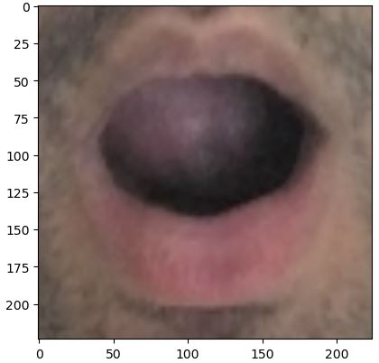
How It Works?
Flask Application
This face features detector identifies 68 main positions (x, y coordinates) on human faces, as shown in figure.
Examples of cropped landmarks:

Slide 16
How It Works?
Flask Application
Cropped images are preprocessed upon entered to the model.
Processed images are fed into CNN model for prediction.
API returns result of prediction back to flutter app.

Slide 17
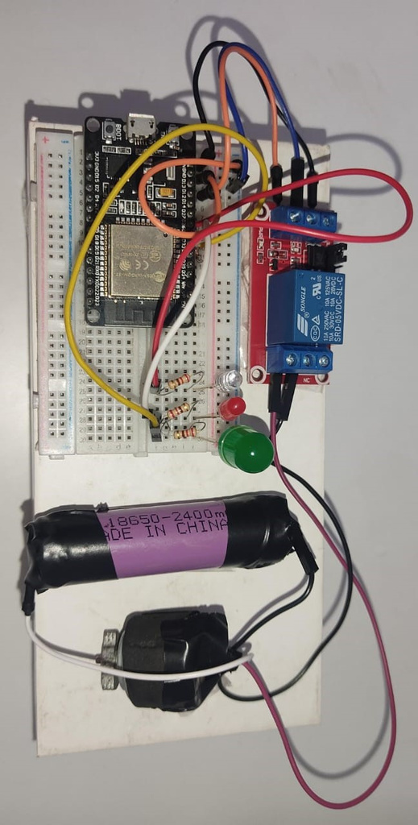
How it works
Hardware Components:
The fundamental concept revolves around the ESP32 monitoring a value from the Firebase Realtime Database, which is stored in a variable named "level," denoting the instances when the driver is detected as drowsy.

Slide 18






How it works
Real-time Alerts:
Alerts are delivered through a graded system that includes sound alert, visual cues, sound alert, vibrations and frequent notifications for drowsiness detection .
01
02
03
04
Sound
LED
Vibration
Notification

Slide 19
How It Works?
Real-time Alerts Mechanism
When drowsiness is detected, the system provides real-time alerts to the driver.
After 3 consecutive drowsy detections, app sends level 1 to Firebase Realtime Database and play an alert sound.
After 6 consecutive, send level 2.
After 9 consecutive, send level 3.
After 12 consecutive, send a notification to interest person.

Slide 20
How It Works?
Real-time Alerts Mechanism
When ESP32 reads the value of level 2 from firebase database, it turns on the led bulb.
And when it reads the value of level 3, it operates the vibration motor that attached to driver seat.
The notification sent to interested person make him call the driver for staying with him upon reaches his destination.

Slide 21
How It Works?
User-defined Precautionary actions
User can choose / define some Precautionary actions that the system can take if the system alerts failed to wakeup the driver such as :
Change to auto drive system
Using Smart car parking system
Contact one of the driver relatives

Slide 22
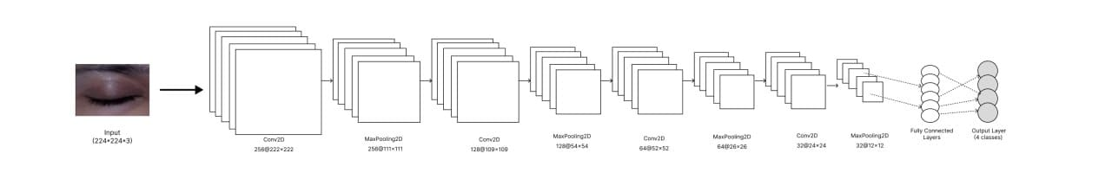
How it works
Drowsiness Detection model :
we use Convolutional Neural Network (CNN) model
Includes four labels: Closed eye, Open eye, Yawn ,No-yawn.
Model Architecture:

Slide 23
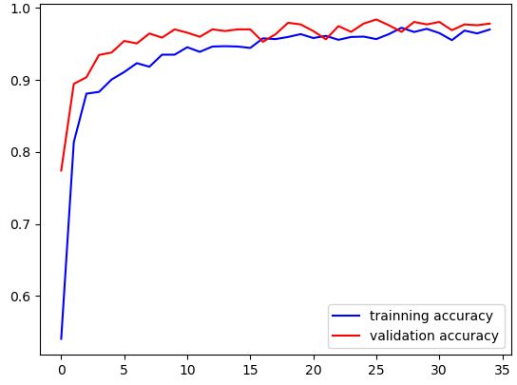
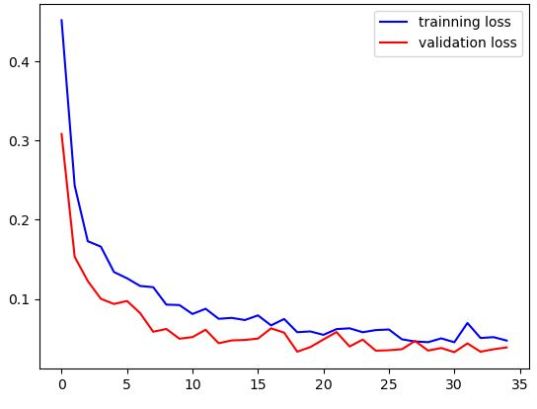
How it works
Drowsiness Detection
We achieved up to 97% accuracy for the drowsiness model
Model Performance Metrics:

Slide 24

Competitive Analysis

Slide 25


Competitive Analysis
Features
Valeo
verizon telematics
guardian fleet
Smart eye
Route Eye
Cost effect
Mobile app
levels of alert
Facial expression analysis
object detection
Drowsiness

Slide 26

Competitive Advantages
Analyzing the driver's face to detect drowsiness.
Cost-Effective Mobile App.
Multi-tiered Alert System for effective communication and prompt response.

Slide 27

Business Model

Slide 28
01
02
04
05
07
Key Partners
Key Activities
Value Proportions
Customer Relationships
Customer Segments
Develop ML models to detect drowsiness and send alert levels to the driver
initiates a graded alert levels system
Enhanced Safety and Accident Prevention.
insurance providers.
Seamless Integration and User-Friendly Design
Self services
(Feedback,
Review,Rating)
App Support,
App Analytics
Individuals
Taxi Drivers
driving schools
Drowsiness Prevention for Focused Driving:
Real-time Alerts for Proactive Intervention
06
Long-Distance Truck Drivers.
Parents distracted by children
Automotive Manufacturers:
Government transportation sector
Channels
Transportation and shipping companies
03
Advanced Drowsiness Detection
Individuals
Cost-Effective and Versatile Solution
Key Resources
Social Media Advertising
Mobile App
ML Engineers
App developer
Hardware
08
Cost Structure
09
Revenue Streams
Mobile app development
Cloud hosting
Marketing
Server maintance
Hardware
subscription
partnership and collaboration
collaborate with driving schools
data analytics services

Slide 29

Market Opportunity
The global market for driver safety solutions is growing rapidly.
Increasing awareness and regulations related to driver safety create a favorable market environment.
Our solution addresses a critical need in the market for accurate drowsiness detection.
Eye Route has the potential for widespread adoption among individual drivers, fleet operators, and ridesharing services.

Slide 30
How can the Route Eye System help develop Egypt's Vision 2030 ?

Slide 31



Improving Transportation Efficiency
Reduction in Traffic Accidents
Enhancing Road Safety
Adoption of Advanced Technologies
International Collaboration and Partnerships
Digital Transformation and Innovation

Slide 32
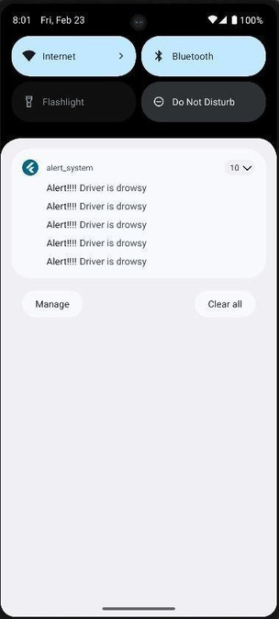
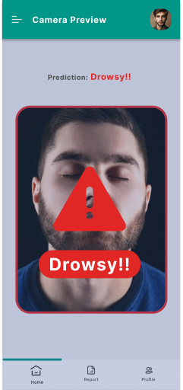
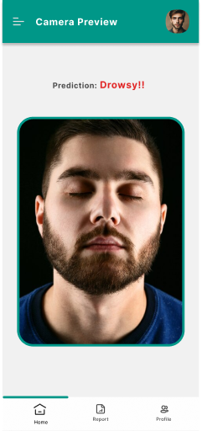

ROUTE EYE
APPLICATION
The camera preview that provide real time detection, Start detection drowsy state then app in , Then send Alerts to the driver to attention,
Notification sent to those following the driver when a state of drowsiness is detected.

Slide 33

Our Team Members
Mariam Al-hussiny
Youssef Khalil
Mariam Ahmad
Nawal Abdelkalek
Yousef Ibrahim
Mariam Osama

Slide 34
Thank you
I really appreciate your time.

